Slide 1





Virtual Job Fair +
An Introduction
6-22-22
© 2022 Geographic Solutions, Inc. All right reserved. The information contained in this presentation is to remain strictly confidential and should not be distributed.

Slide 2
Introduction
Virtual Job Fair + allows employers and individuals additional freedoms for scheduling interviews
Direct response to dealing with COVID and the need to meet virtually.
Zoom is the official virtual meeting tool.
Employers see candidate overviews within VJF in order to make intelligent decisions
Chat and Meeting features
Integrates 3 users in one: Staff, Individuals, and Employers

Slide 3
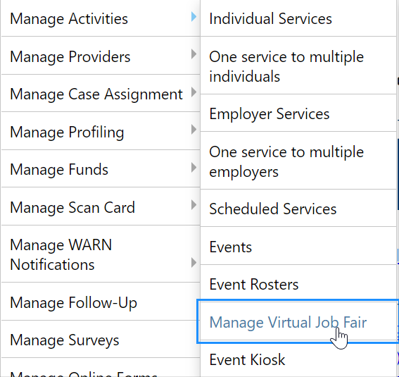
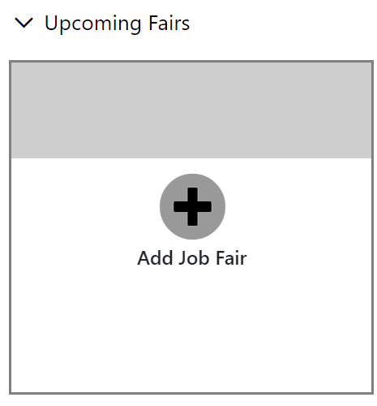
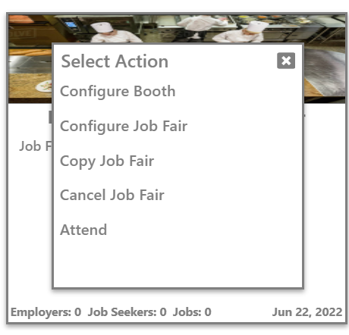
Creating a Job Fair
Staff are responsible for creating the job fair through Manage Activities > Manage Virtual Job Fair.
They will see a list of Upcoming and Past Job Fairs. To create the job fair, click the box to “Add Job Fair.”
Once a job fair is established, staff can return to it and conduct multiple tasks: Configure the Booth, Configure Job Fair Details, Copy the Job Fair, Cancel the Job Fair, and Attend. Based on privilege settings, multiple staff can share responsibilities.

Slide 4
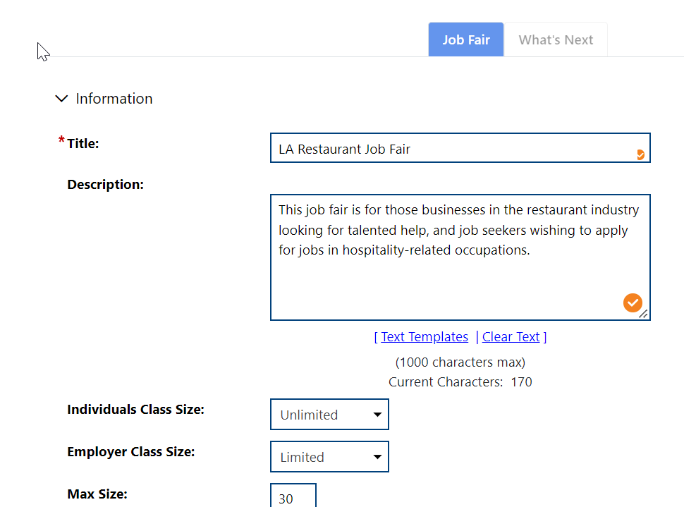
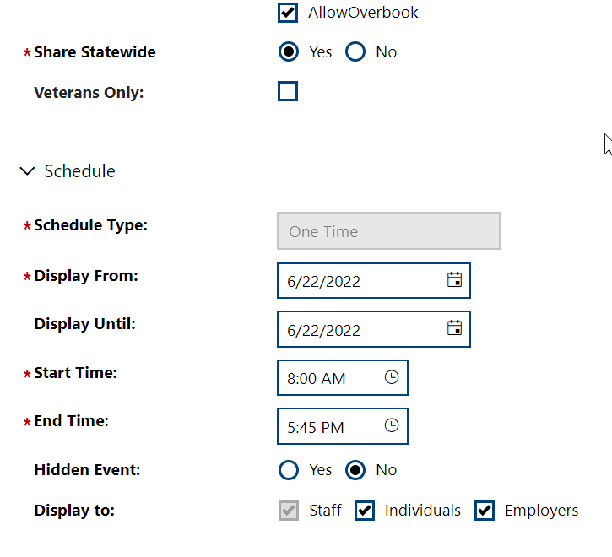
Step One: Job Fair Details
The first step is to provide basic information on the Job Fair. Anyone with experience creating a regular event or meeting will have no problem with this first step. Many of the questions are the same.
This is in the Job Fair tab.

Slide 5
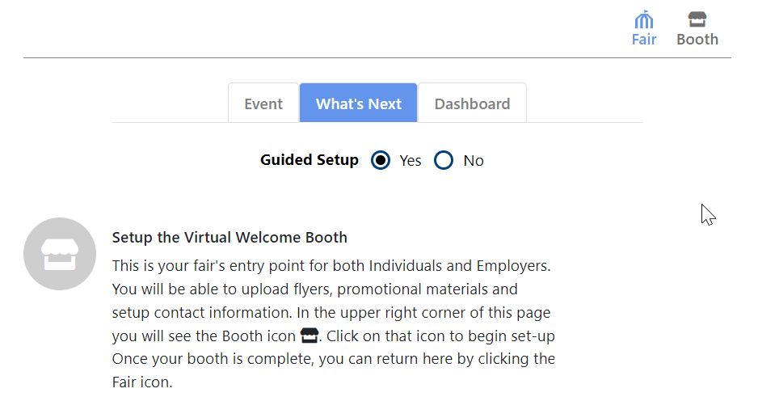
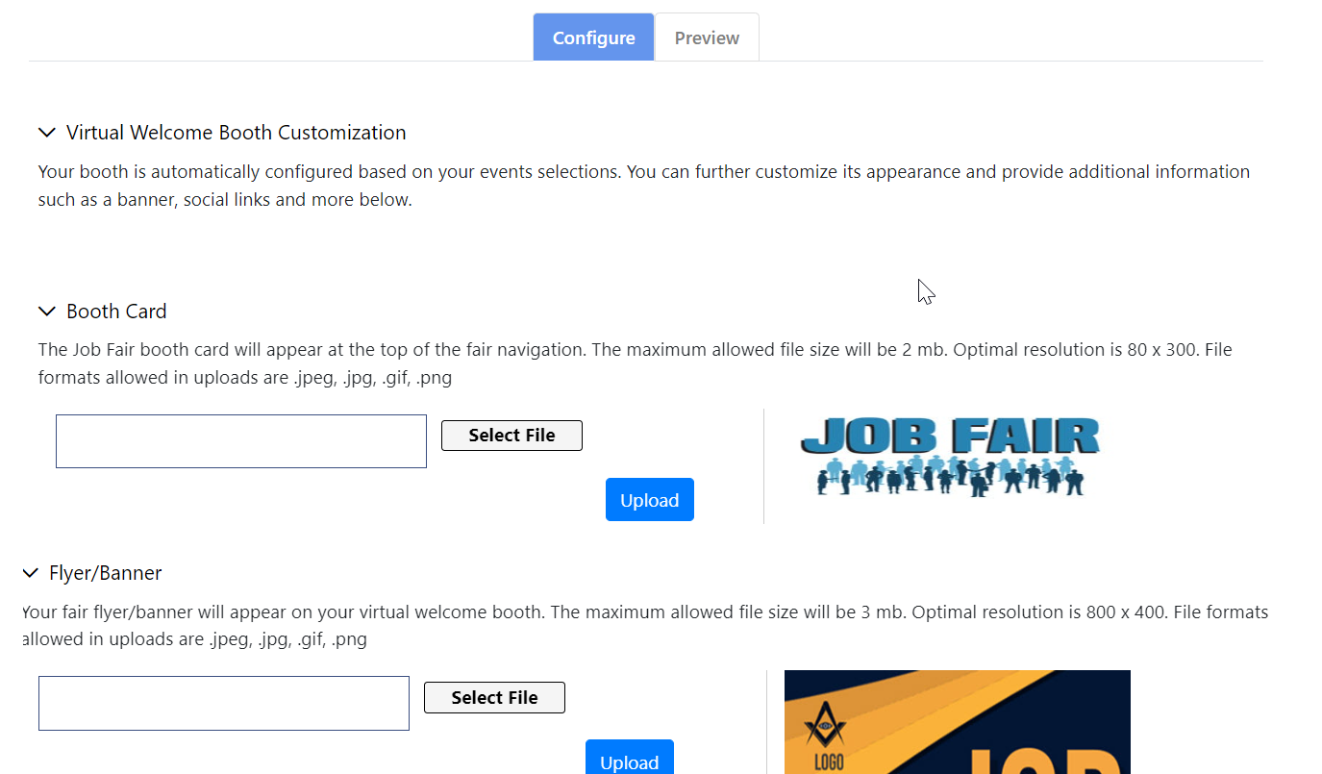

Step 2: Setting Up the Virtual Welcome Booth
There is a step-by-step guide to setting up the booth.
For Guided Setup, say Yes.
Next, add a booth card, a flyer, and identify the staff organizer. Select images and upload them.
Pay close attention to the image resolution rules, or the images may look too wide.
Make the job fair visually appealing.

Slide 6
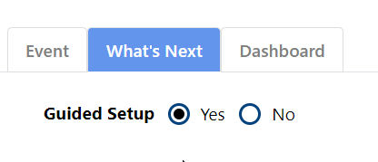
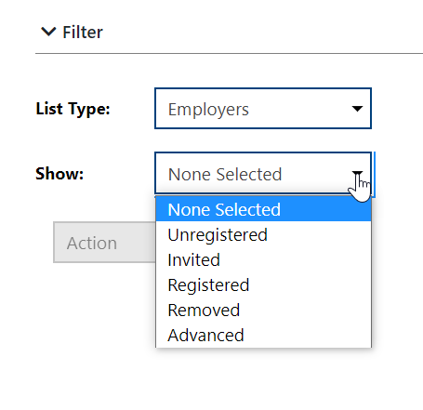
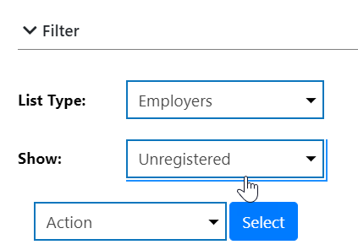
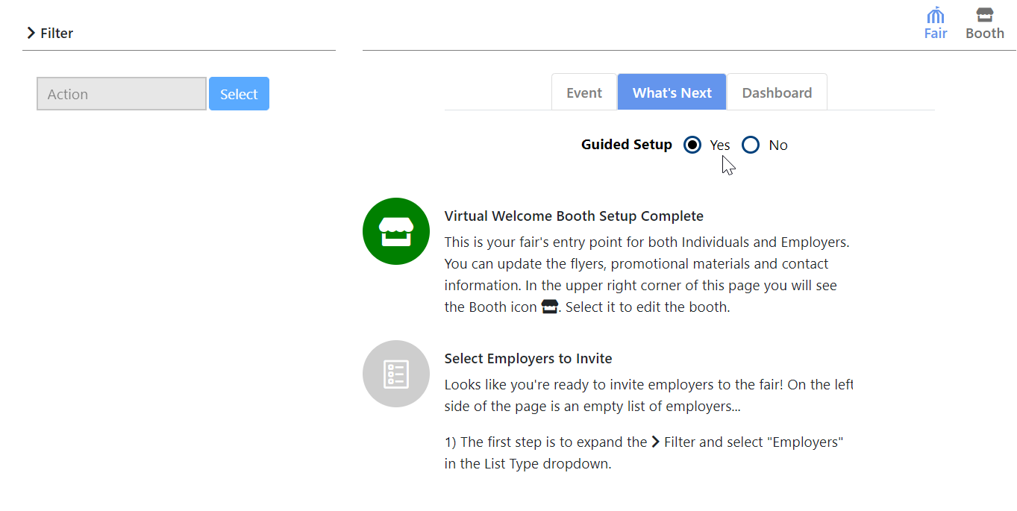
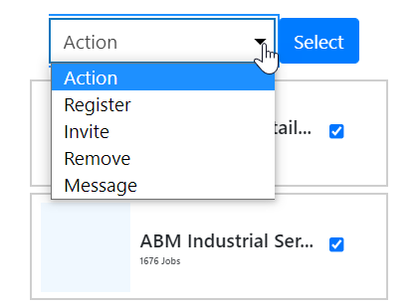
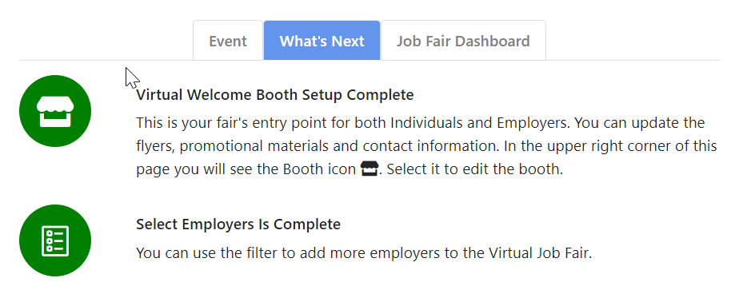
Step 3: Selecting Employers to Participate
Once the booth is setup, the icon turns green. Direct your attention to the next step right below it.
You can select employers to invite to the job fair, remove, and register.
To register employers, go to the filter and select Unregistered. This will be a long list. Employers will appear in order by available jobs.
Click on the check boxes.
Go to the Action column and click to “Register.”
Most actions are conducted through the Filter on the left.

Slide 7
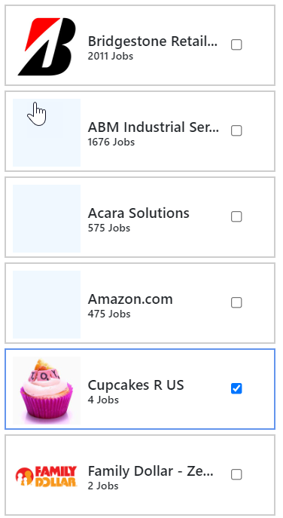
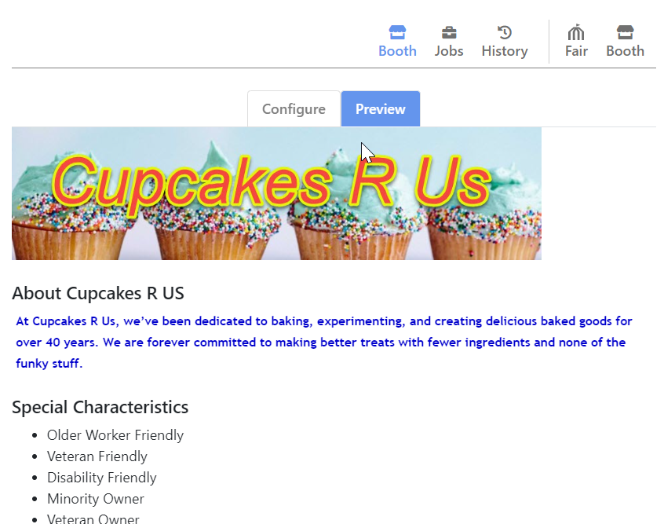
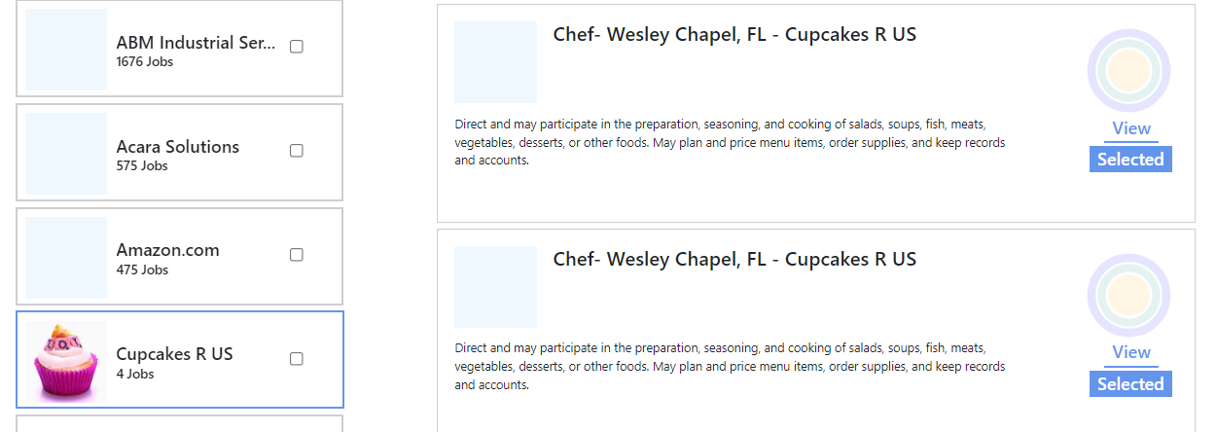
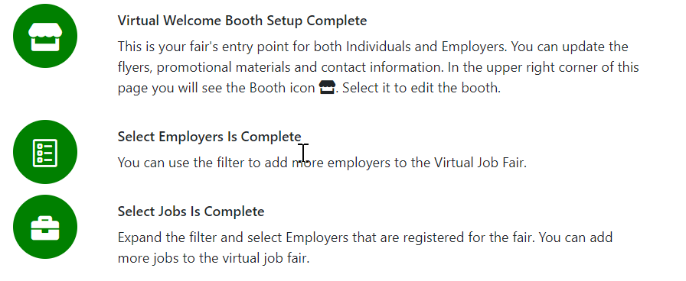
Step 4: Once There are Employers, Now we Need Jobs.
Once there are employers registered, now staff can help to select featured jobs available.
Click a registered employer. You can view their information. They can design their own profile.
Go to the Jobs link. It will display current jobs. Click to “Select” and those jobs will be selected.
Individuals can view those jobs when they check out the job fair.

Slide 8
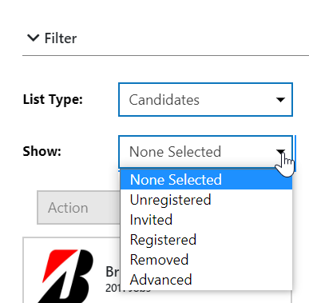
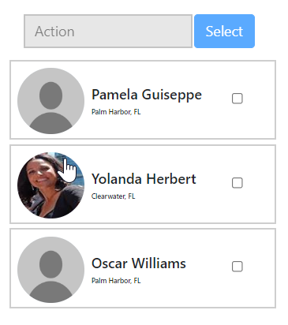
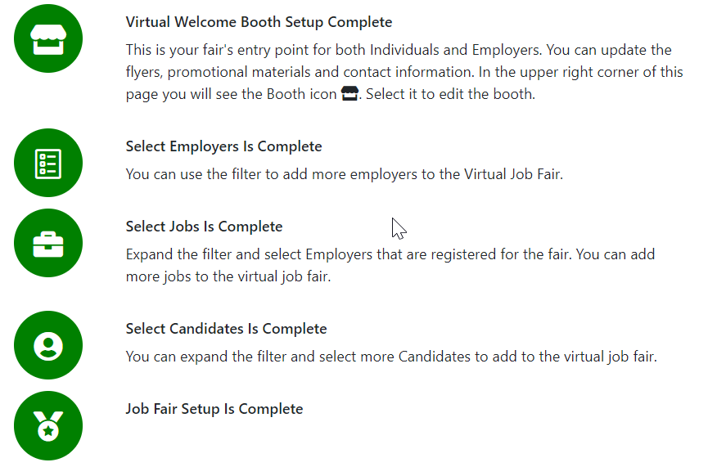
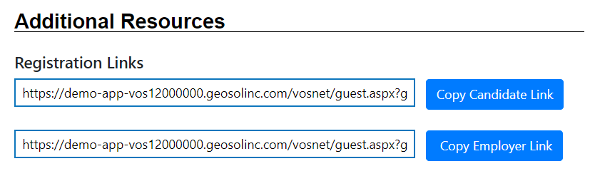
Step 5: Assisting with Individual Job Fair Registration
Staff can help register individuals for the job fair, but individuals can register on their own. This is based on how the job fair is set up.
Go to the filter and select Candidates. Then use the filter to pick the type of candidate status you are looking for.
If you select Unregistered, under Action, click Register. That will automatically register multiple individuals at once.

Slide 9
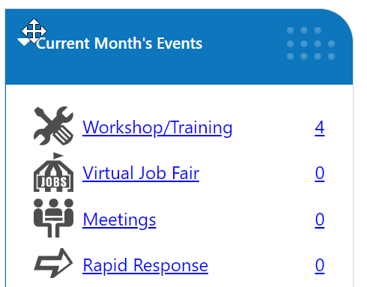
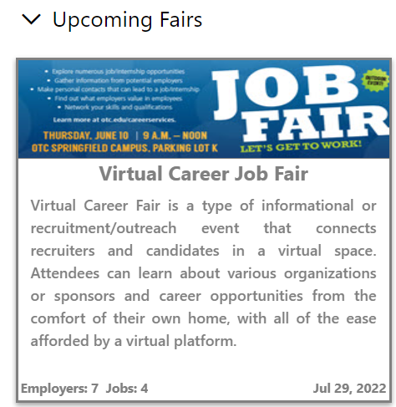
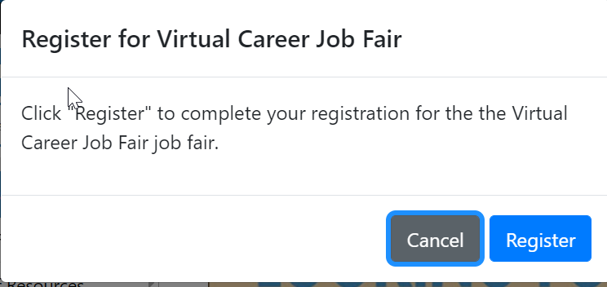
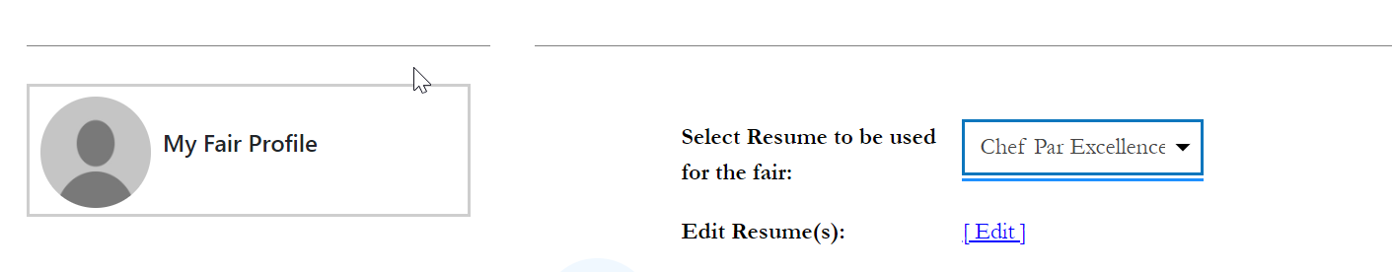
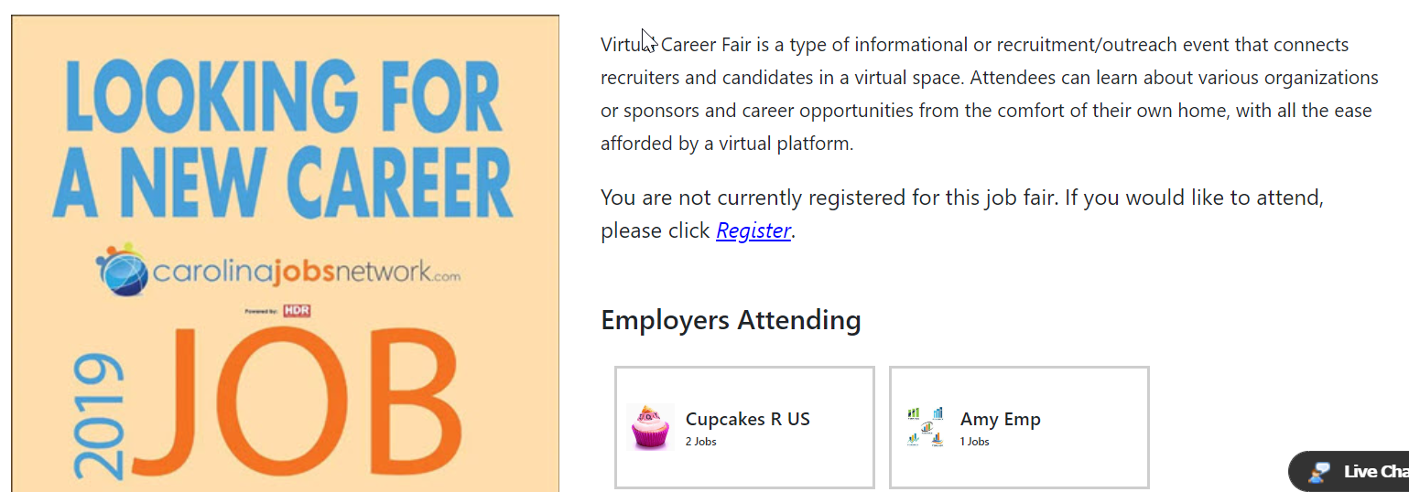
Individual Self-Registration for a Virtual Job Fair
Go to the Current Month’s Events Widget. Click on Virtual Job Fair.
Upcoming Job Fairs in the current month will appear.
Click on the card for the one you wish to register for.
Register
Update and select your resume.
Check out employers and jobs.

Slide 10
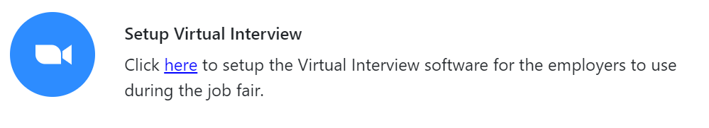
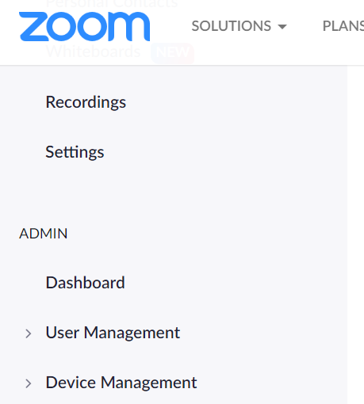
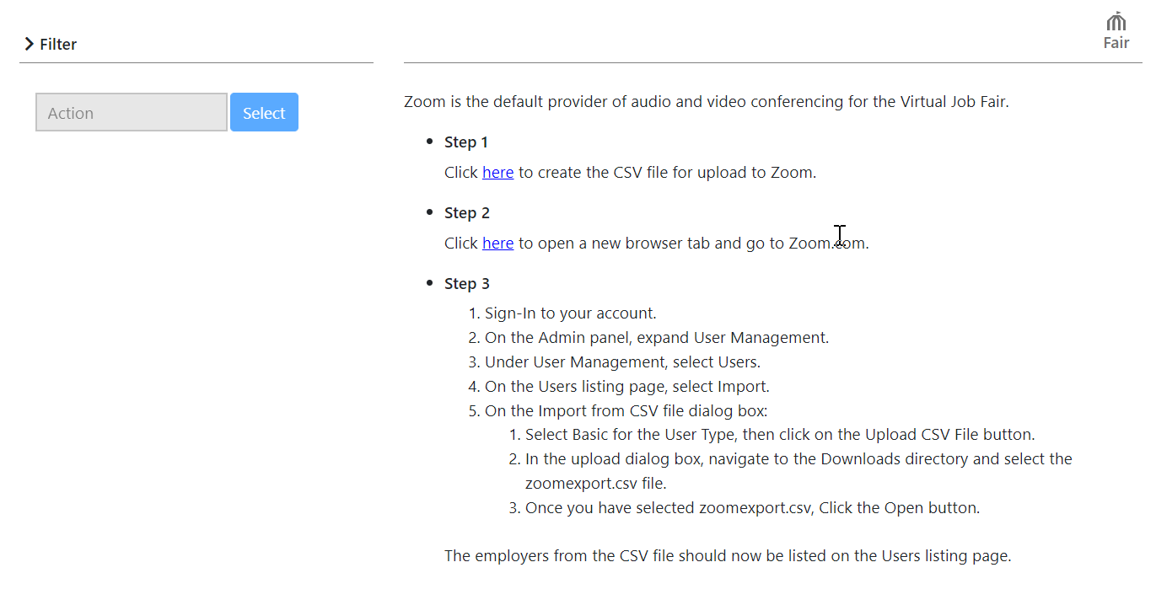
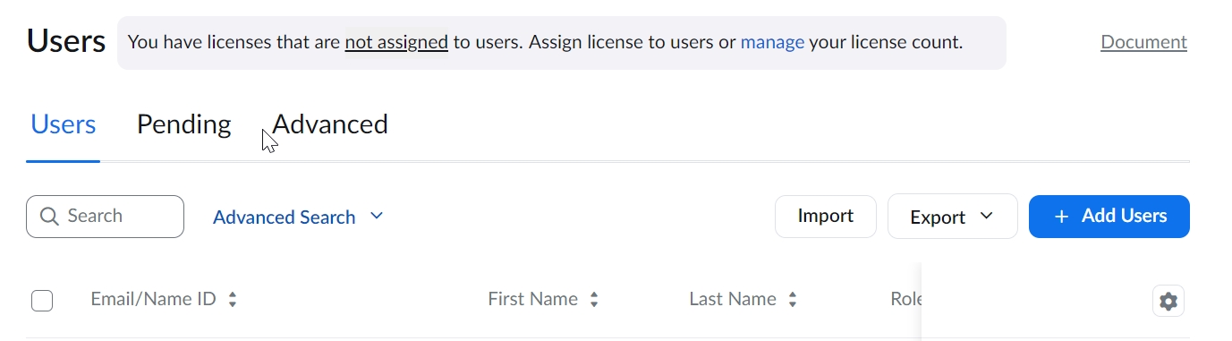
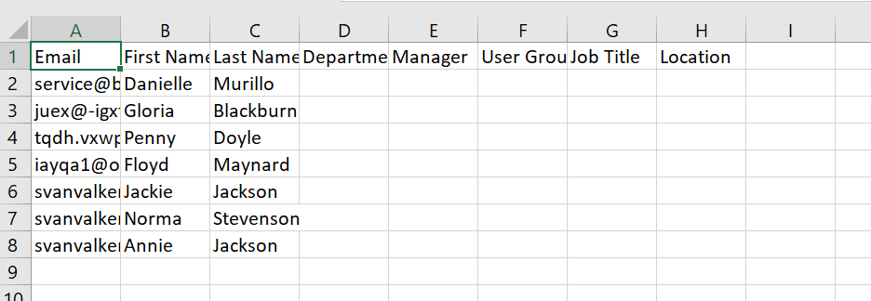
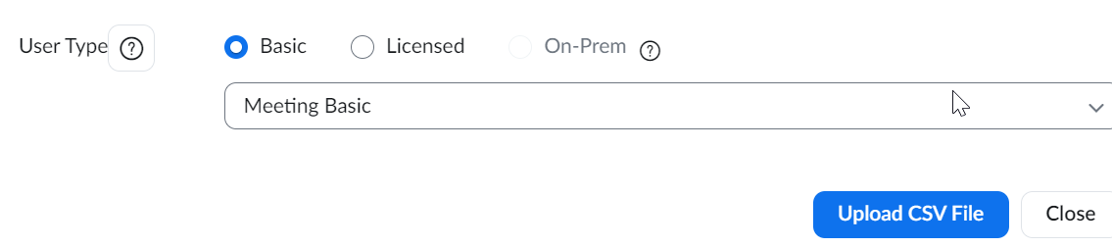
Step 6: Setting Up Virtual Chat
Setting up to conduct a virtual chat is a step-by-step process. There are multiple steps, but the steps are outlined in the Guided Setup.
These steps must be followed.
These screens represent some of the significant steps.

Slide 11
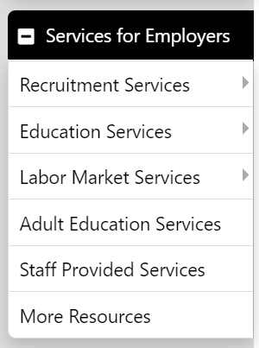
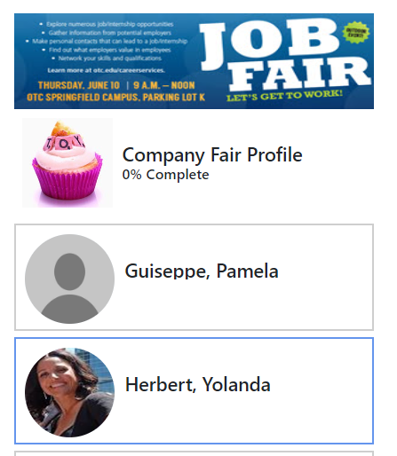
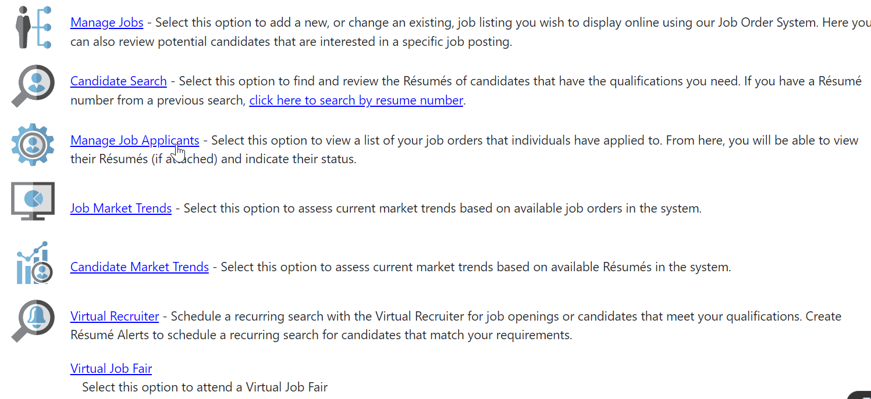
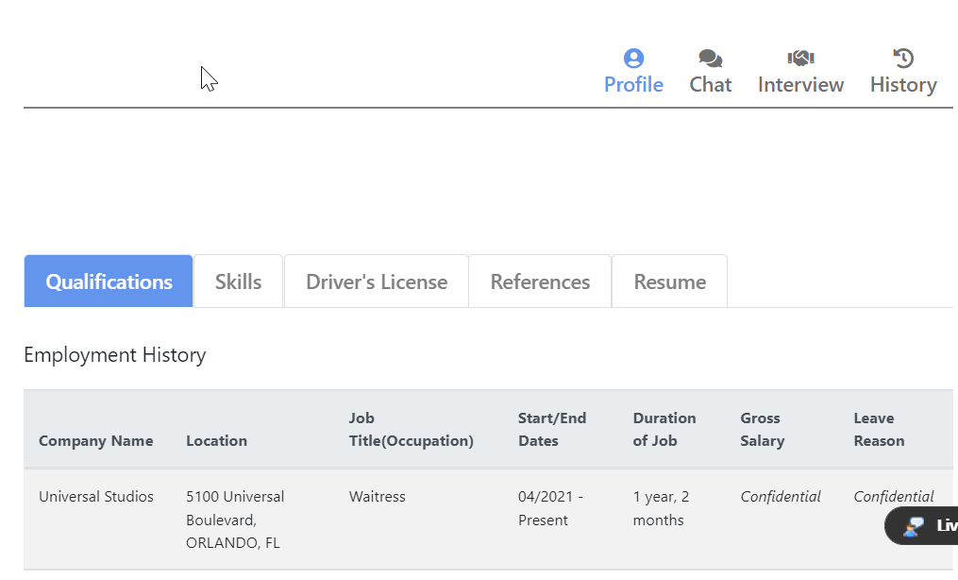
Step 7: Employers Reviewing Registered Job Seekers
Employers can review registered candidates. They go to Services for Employers > Recruitment Services.
At the bottom is a link to Virtual Job Fair. Pick the job fair you are associated with.
Work on my profile if necessary.
Click on a candidate that has registered.
Under Profile, you will see THEIR profile information in order to make informed decisions on who to interview.

Slide 12
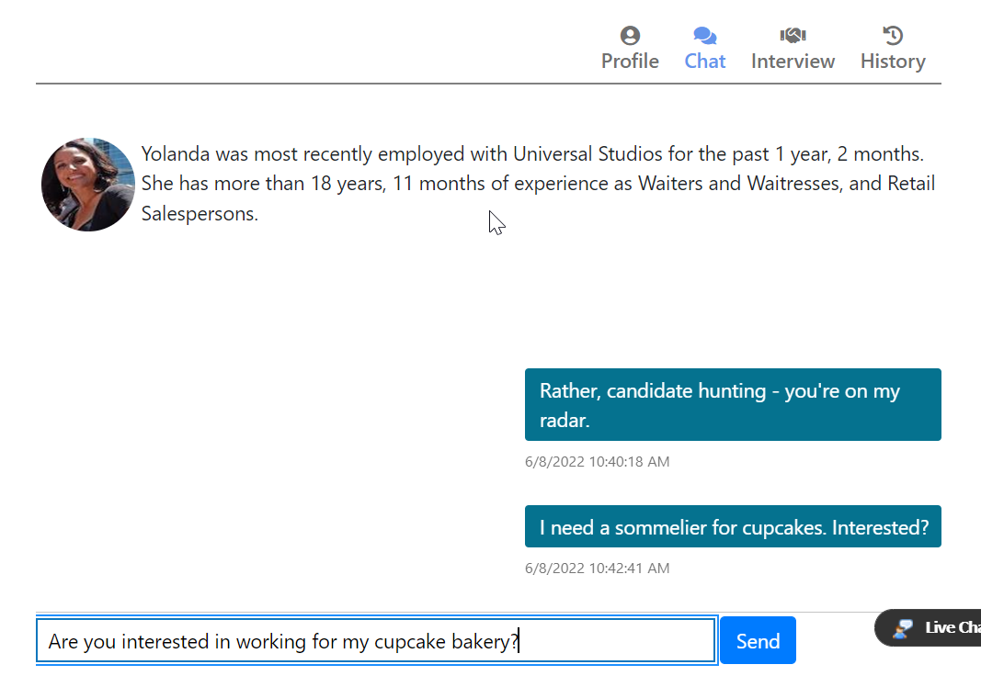
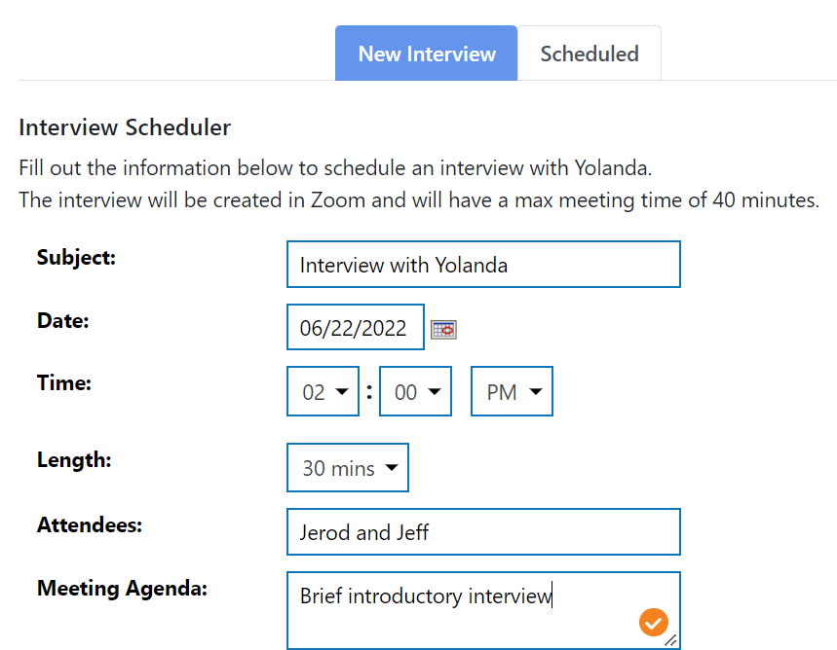
Step 7: Employers Reviewing Registered Job Seekers
On the day of the job fair, you can chat with a potential candidate.
If the chat goes well, you can set up a Virtual Interview.
Employers can also look at Scheduled interviews as well.

Slide 13
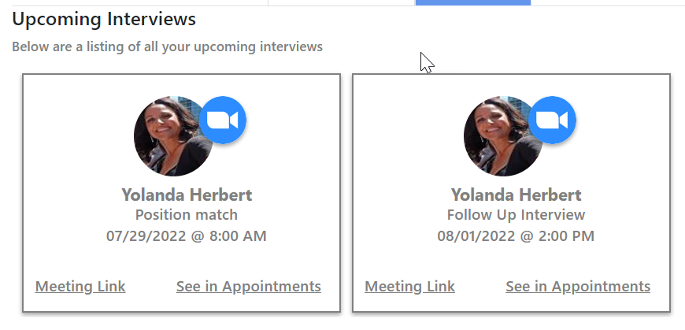
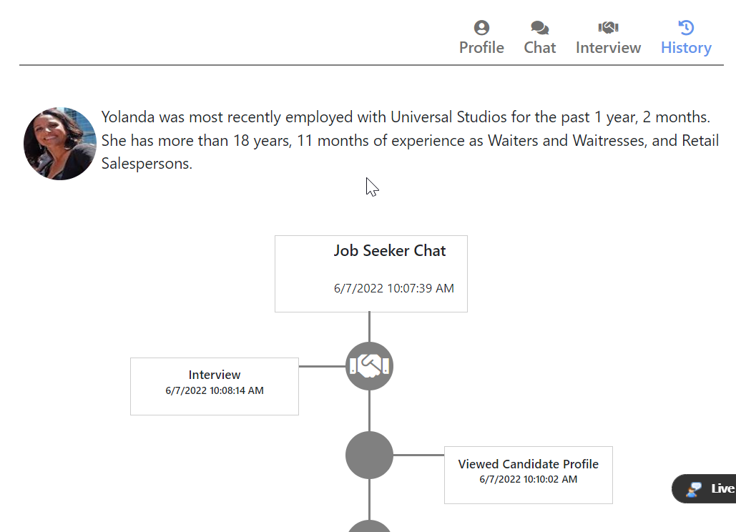
Step 7: Employers Reviewing Job Seekers
An Interview Card appears for scheduled interviews.
Click a Meeting Link when it is time to conduct the interview.
See the Virtual Interview in the Appointments Calendar too.
All interactions include a History icon to review everything done during the job fair.
Employers and Candidates both have a History.

Slide 14
Ending
Building Integrated Workforce Development Systems
© 2022 Geographic Solutions, Inc. All right reserved. The information contained in this presentation is to remain strictly confidential and should not be distributed.

